Slide 1
SMART SHOPPING APP
DESIGN PROJECT: PHASE 3
TEAM MEMBERS:
AIDA EMMANUEL ANU MARY ABEY ANUSREE RAVEENDRAN
ARYA P.S.

Slide 2

REQUIREMENT ANALYSIS

Slide 3
PROBLEMS FACED
In a supermarket, customers find it difficult to know the bill details in advance before reaching the billing counter and to find the exact location of the desired item from racks.

Slide 4
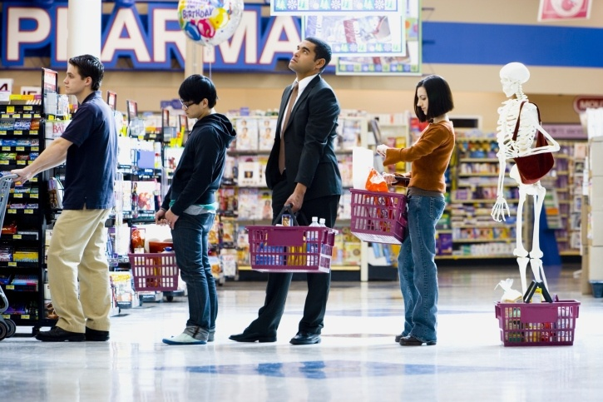

Slide 5
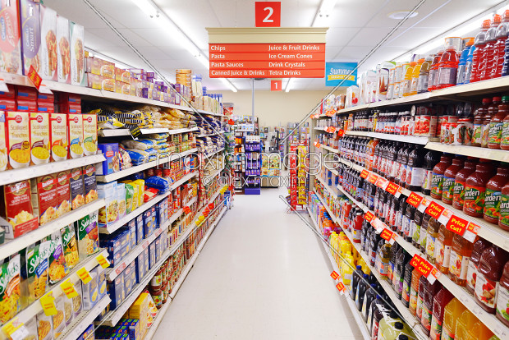

Slide 6
CURRENT SCENARIO
While shopping, consumers face many problems such as uncertainty about whether the amount of money would be sufficient to pay the total bill amount and having to wait for extended periods of time in queues at billing counters.

Slide 7
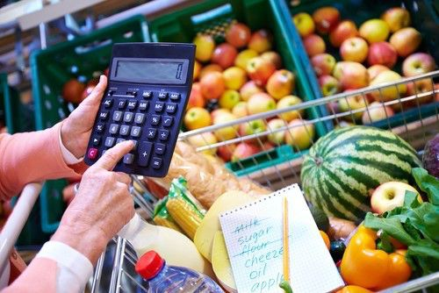

Slide 8
OBJECTIVE
As a solution to the problem, we suggested that a mobile application be implemented to provide a smart and comfortable shopping experience to the customers.

Slide 9
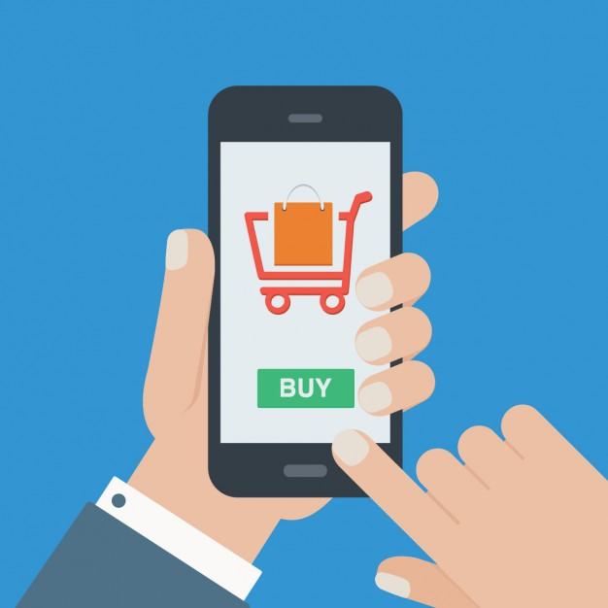

Slide 10
SOLUTION PROPOSED
There are beacons placed at the store’s entrance which alerts the customer’s bluetooth enabled phone as the customer walks into the store. As the signal emitted by the beacon is received by the smartphone, the store is identified and the customer can upload his/her shopping list onto the mobile application.

Slide 11


Slide 12
As per the contents of the shopping list, the application provides the shortest possible route map across the store. The location of the products are identified using ZigBee technology. If the customer does not wish to upload the list, one can also search for the product by name.

Slide 13
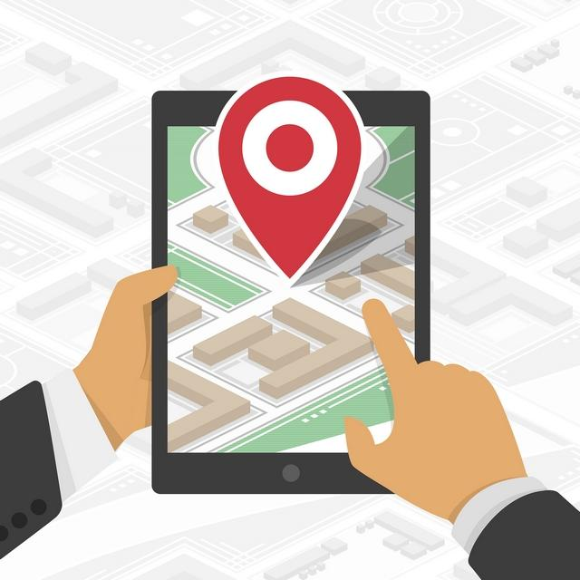

Slide 14
On finding the product, customer can use their smartphones to scan the barcodes on products and they are automatically added to the billing list. If the customer would like to remove a product from the cart, he/she can do so. In case of an unsuccessful attempt, manual entry is also supported.

Slide 15
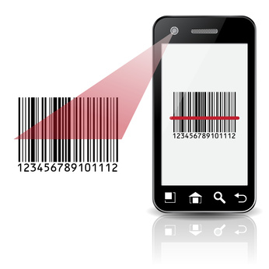

Slide 16
As each product is removed from the shelves, sensors embedded on the shelves keep a temporary count of the number of remaining items of the product.
On completing the shopping, the customer can review the bill and proceed for payment via the mobile application. After payment, a proof of purchase is generated. Then, stock inventory of the shop is finally updated and a notification is issued to the shop if it falls below the set threshold.

Slide 17
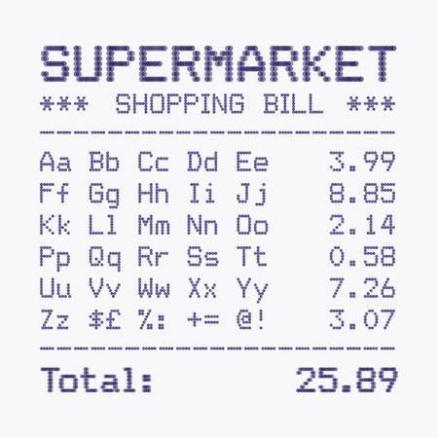

Slide 18

PROJECT OBJECTIVE

Slide 19
DESIGN & IMPLEMENTATION CONSTRAINTS
Beacons & Zigbee sensors should be placed at regular intervals throughout the supermarket
The cost of installing sensors for each of the shelves should be borne by the supermarket
May face difficulty in integrating the application data with the supermarket database

Slide 20
PROBLEM ANALYSIS:
We propose to design a smartphone application based on beacon and Zigbee technology.
This application can be used to navigate the customer to the desired product and they can know the billing information beforehand. Items are scanned using mobile scanner and billed.
In this way, customer can avoid long supermarket queues in supermarket and make payment easily.

Slide 21
Technology Used
A beacon is a small Bluetooth radio transmitter which broadcasts a radio signal that is made up of a combination of letters and numbers transmitted on a regular interval of approximately 1/10th of a second. The communication is only one way i.e. only retailer can connect with customer.

Slide 22
Technology Used
ZXing is a barcode scanning library for Android.
Zigbee is a wireless communication standard that defines a wireless protocol for use in low data rate, short to medium range wireless networking device like sensors and control network. Here the pulses send by Zigbee sensors are used to identify location of products. These sensors are placed on every rack.

Slide 23
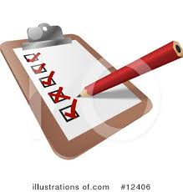
SYSTEM OVERVIEW & REQUIREMENTS

Slide 24
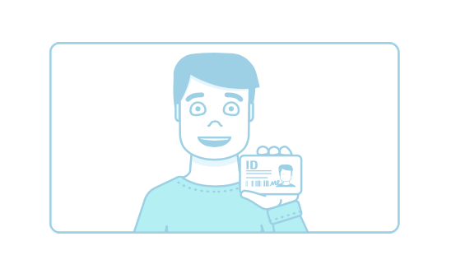
FUNCTIONAL MODULES
User registration:
User should verify their mobile number
Create Shopping list:
User create their shopping list

Slide 25
FUNCTIONAL MODULES
Start shopping:
User uploads the shopping list and a map showing the location of each item is generated.User scans the barcode to get the price and receives a billing page.
Payment:
User can pay the bill using any of the available payment modes.

Slide 26
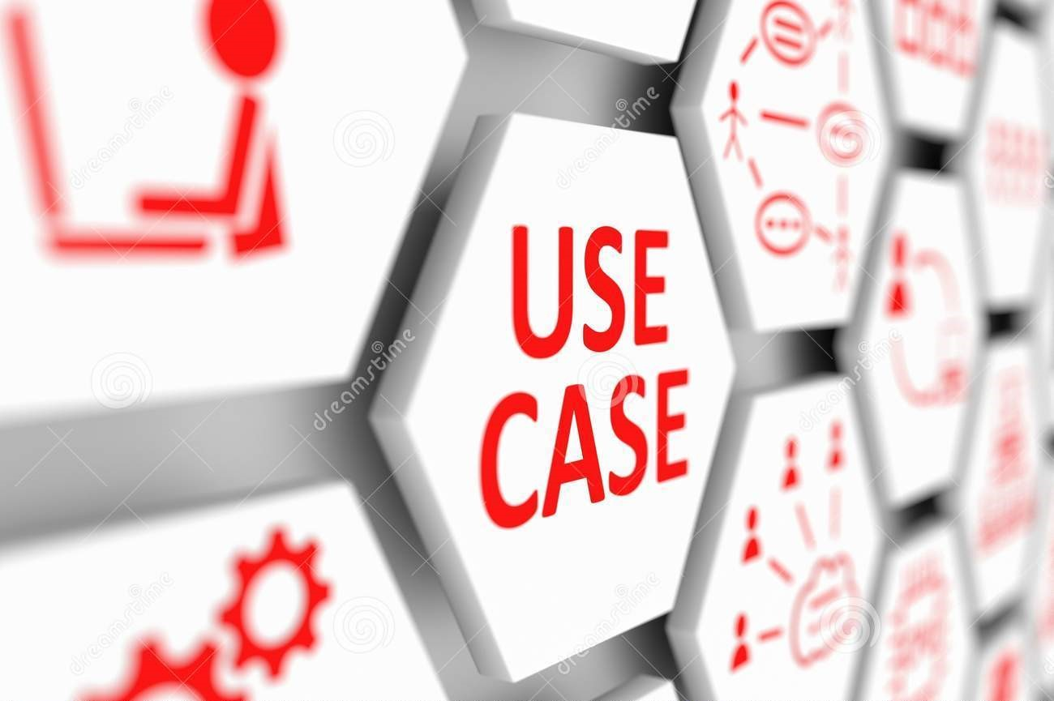
USE CASE DIAGRAM

Slide 27
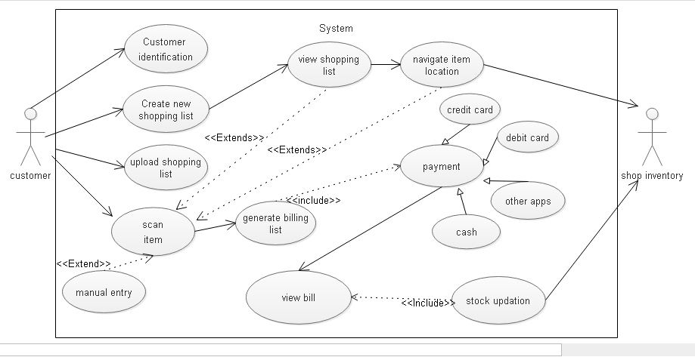

Slide 28
USE CASE SPECIFICATION

Slide 29
Use Case ID | APP_M_1
Use Case Name | Customer Authentication
Description | On installing the app, the user is prompted to verify their mobile number
Assumption | The app has been installed on the phone
Precondition | The app has been installed on the phone
Flow of events | The user is prompted to enter their name and phone number On receiving the verification code, the user’s phone number is confirmed
Post Condition | Customer identity authenticated

Slide 30
Use Case ID | APP_M_2
Use Case Name | Customer Identification
Description | As the customer enters the supermarket, the beacon set up at the entrance notifies the customer
Assumption | Customer authentication is complete
Precondition | Bluetooth has been enabled on the customer’s phone
Flow of events | On receiving the beacon signal, a notification appears on the customer’s phone specifying customer name and supermarket name The customer must then open the app to proceed
Post Condition | Customer identified

Slide 31
Use Case ID | APP_M_3
Use Case Name | Create Shopping List
Description | The homepage of the app displays two options-to create a shopping list and upload a shopping list.
Assumption | Customer verification is complete
Precondition | The app has been installed on the phone
Flow of events | The customer selects the create shopping list option The customer then enters the name of the item required. Auto-suggestions are displayed as the user types. Click the add item button to include an additional item on the shopping list and repeat step 2. Once the complete list is entered, the customer can submit the list and the list is created. 3A. To remove an item from the list customer can click the remove item button
Post Condition | Shopping list is created and saved

Slide 32
Use Case ID | APP_M_4
Use Case Name | Upload shopping list
Description | If the customer chooses the second option, the customer uploads the shopping list of his choice from all the saved lists
Assumption | A shopping list has been created
Precondition | A shopping list has been created
Flow of events | Choose a shopping list from the list of saved shopping lists Upload the list 1A. If there are no saved lists, create a shopping list 2A. If user wants to edit the list, edit the list before uploading
Post Condition | The shopping list has been uploaded

Slide 33
Use Case ID | APP_M_5
Use Case Name | View shopping list
Description | View the uploaded shopping list
Assumption | The required shopping list has been uploaded
Precondition | The required shopping list has been uploaded
Flow of events | View the shopping list Show the shortest route across the shop 2A. Show the location map of each product 2B. Scan the barcode
Post Condition | The confirmed shopping list can be viewed

Slide 34
Use Case ID | APP_M_6
Use Case Name | Location map
Description | View the location of the products in the store
Assumption | The location map and rack arrangement of all products placed in the supermarket are available
Precondition | The shopping list has been uploaded
Flow of events | The shortest route to the next product on the list is shown to the customer as directions around the supermarket Once the location is reached, scanning can be done 1A. The shortest route to the specified product is shown
Post Condition | The required product is located

Slide 35
Use Case ID | APP_M_7
Use Case Name | Scan barcode
Description | Once the required product is reached, scan the barcode to get the product ID
Assumption | All product IDs are available in the database
Precondition | All product IDs are available in the database
Flow of events | Once the customer picks the product off the shelf, the product’s barcode is scanned. Once the product ID is received, the item is added to the billing list. 1A. If the scanning process was unsuccessful, the customer can alternatively manually enter the product ID
Post Condition | The scanned item is added to the billing list

Slide 36
Use Case ID | APP_M_8
Use Case Name | Billing list
Description | The billing list contains the name and price of all the scanned products along with the current total. It is the intermediate list before proceeding for payment.
Assumption | The product ID was successfully scanned
Precondition | The product ID was successfully scanned
Flow of events | The billing list is displayed which contains the name and price of all the scanned products. The current total is displayed at the bottom of the screen. Once done, on clicking proceed for payment, the payment options will be displayed 1A. If any product should be removed from the list, click the remove button 3A. On clicking back button, the show map option and on further clicks, it goes back to the shopping list.
Post Condition | The current total has been calculated

Slide 37
Use Case ID | APP_M_9
Use Case Name | Payment mode
Description | The various payment options available to the customer is displayed and the customer can proceed for payment by choosing anyone of the options
Assumption | The billing list was confirmed by the customer
Precondition | The billing list was confirmed by the customer
Flow of events | The various available payment options like cash payment, credit card payment, debit card payment, net banking and using a payment app. Once the customer pays using the selected option, a billing summary and proof of purchase is generated 1A. If the payment was unsuccessful, an error message is generated and shopping cannot be completed. In that case, the customer is asked to proceed to the billing counter.
Post Condition | The customer pays the total bill amount

Slide 38
Use Case ID | APP_M_10
Use Case Name | Billing Summary
Description | The billing summary and proof of purchase is generated. Billing summary is a read-only list of items bought and the total price paid. Proof of purchase contains the transaction details.
Assumption | The payment was completed by the customer
Precondition | The payment was completed by the customer
Flow of events | The billing summary is automatically generated after the payment is done. It contains all the item names and respective prices along with the total price. The proof of purchase contains the transaction ID, mode of payment and other transaction details
Post Condition | The billing summary and proof of purchase can be viewed by the customer and it is automatically saved on the customer’s phone

Slide 39
Use Case ID | APP_M_11
Use Case Name | Stock updation
Description | The stock count of each item is finally updated, once the bill is paid
Assumption | The bill payment has been completed
Precondition | The bill payment has been completed
Flow of events | Once the bill is paid, the stock inventory of the supermarket is updated. In case the stock count of any item falls below the threshold, the stock manager is alerted.
Post Condition | Real-time updation of stock details is possible

Slide 40
HIGH LEVEL DESIGN
Architecture Diagram

Slide 41
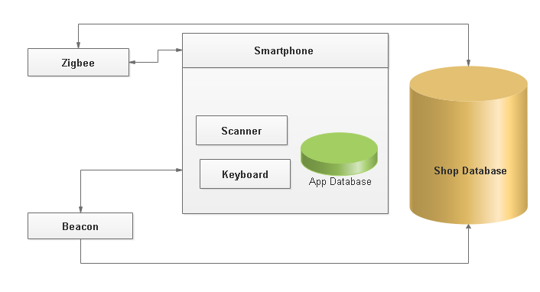
BLOCK DIAGRAM

Slide 42
SEQUENCE DIAGRAM

Slide 43
Customer Authentication

Slide 44
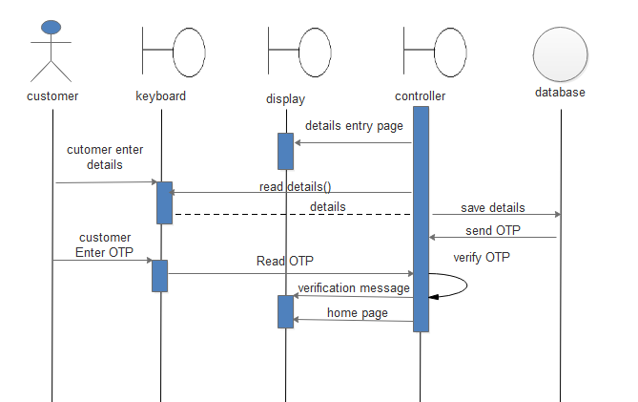

Slide 45
Customer Identification & Creating Shopping List

Slide 46
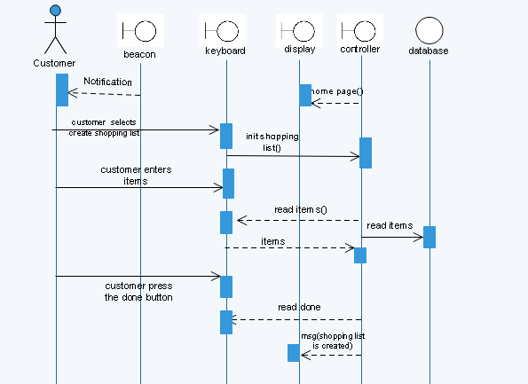

Slide 47
Upload Shopping List, Locate Item, Scan Item & Generate Billing List

Slide 48
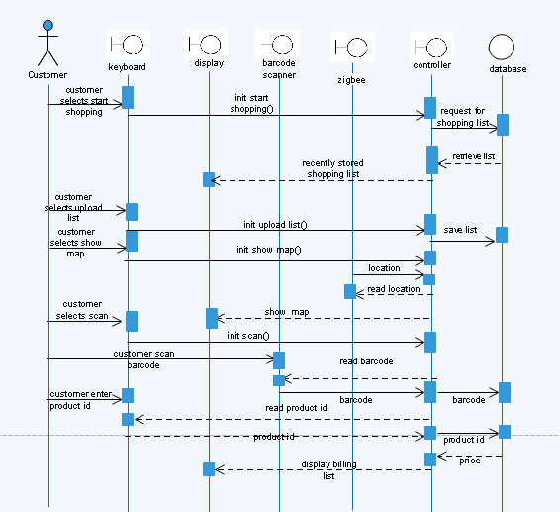

Slide 49
Payment & Proof of Purchase

Slide 50
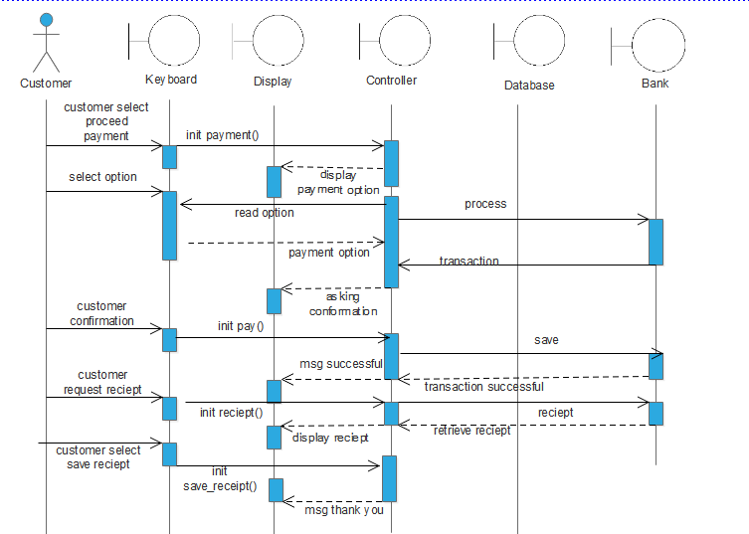

Slide 51
CLASS DIAGRAM

Slide 52
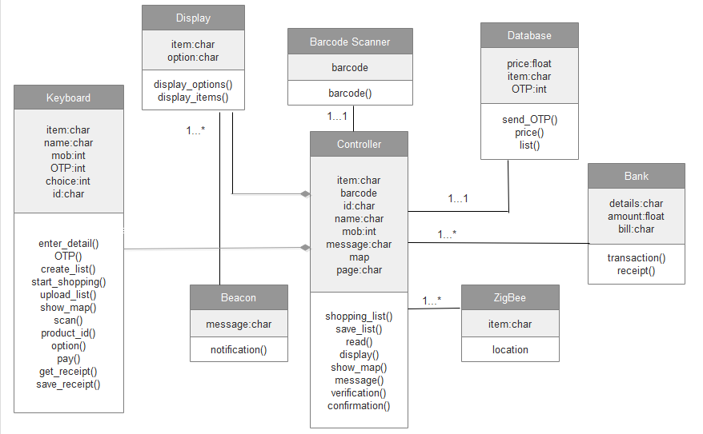

Slide 53

DESIGN

Slide 54
DATA MODEL

Slide 55
ER DIAGRAM

Slide 56
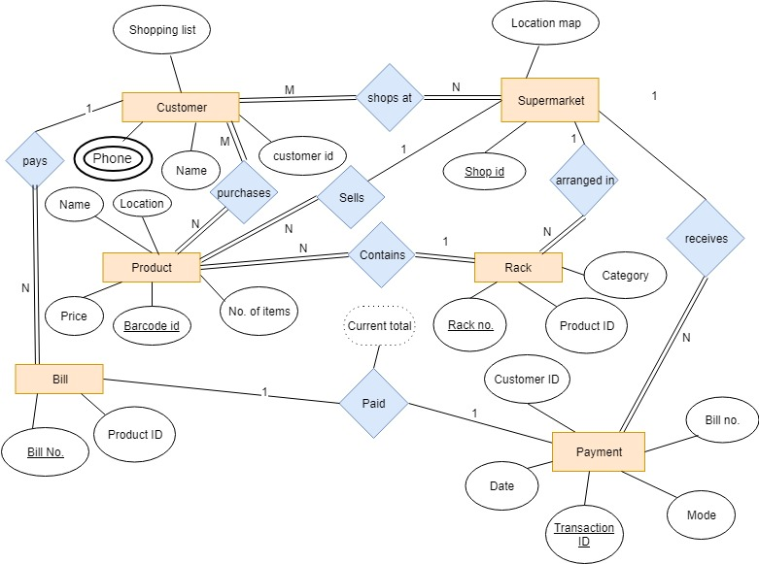

Slide 57
WIREFRAME

Slide 58
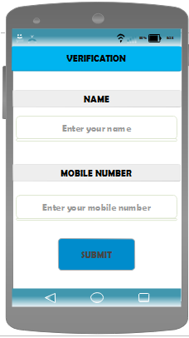
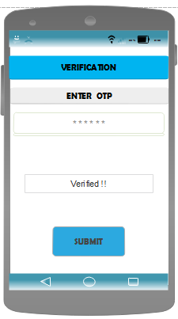

Slide 59
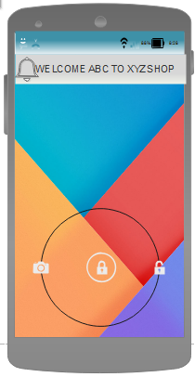
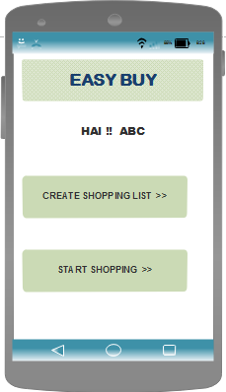

Slide 60
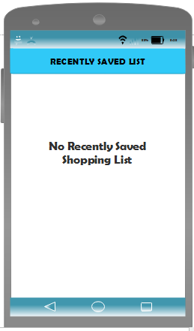

Slide 61
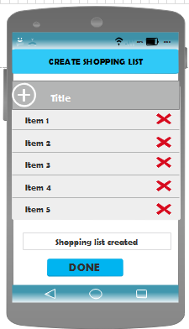

Slide 62
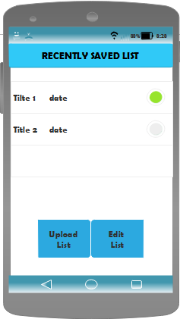

Slide 63
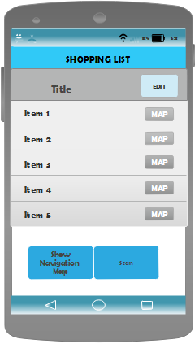
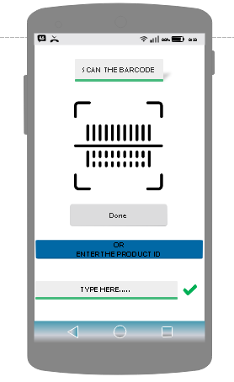

Slide 64
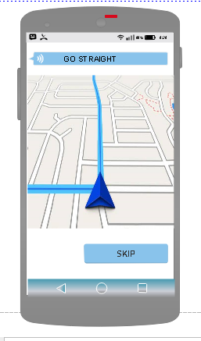

Slide 66
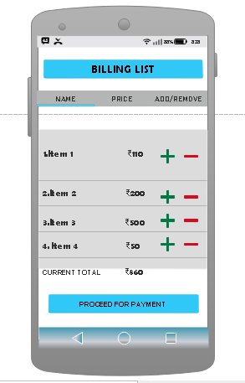
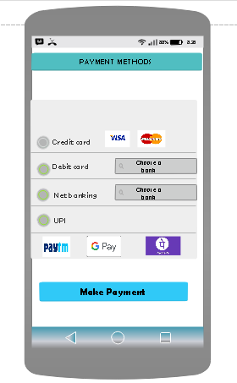

Slide 67
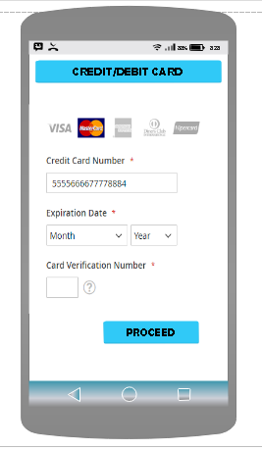
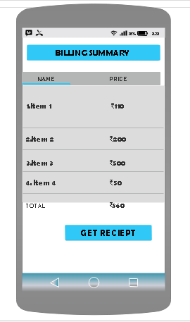

Slide 68
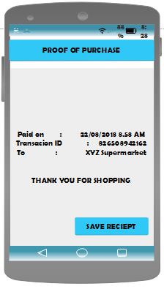

Slide 69
ACTIVITY FLOW

Slide 70
FLOW OF EVENTS
Install the mobile application on the user’s phone
The user is prompted to enter their name and phone number
On receiving the verification code, the user’s phone number is confirmed
As the customer enters the supermarket, the beacon set up at the entrance sends a notification message to the customer’s bluetooth enabled phone specifying customer name and supermarket name

Slide 71
The customer must then open the app to proceed
On opening the app, the homepage displays two options-to create a shopping list and upload a shopping list.
The customer selects the create shopping list option
The customer then enters the name of the item required. Auto-suggestions are displayed as the user types.
Click the add item button to include an additional item on the shopping list and repeat step 8.
Once the complete list is entered, the customer can submit the list and the list is created and saved.

Slide 72
The customer selects the upload shopping list option
Choose a shopping list from the list of saved shopping lists
Upload the list
View the shopping list
The shortest route to the next product on the list is shown to the customer as directions around the supermarket
Once the location is reached, scanning can be done

Slide 73
Once the customer picks the product off the shelf, the product’s barcode is scanned.
Once the product ID is received, the item is added to the billing list.
The billing list is displayed which contains the name and price of all the scanned products.
The current total is displayed at the bottom of the screen.
Once done, on clicking proceed for payment, the payment options will be displayed

Slide 74
The various available payment options like cash payment, credit card payment, debit card payment, net banking and using a payment app.
Once the customer pays using the selected option, a billing summary and proof of purchase is generated
Once the bill is paid, the stock inventory of the supermarket is updated.
The billing summary is automatically generated after the payment is done.
It contains all the item names and respective prices along with the total price.

Slide 75
Then the proof of purchase is generated which contains the transaction ID, mode of payment and other transaction details.

Slide 76
LIMITATIONS
If the product is misplaced on a different rack by the customer, it may lead to erroneous stock count collected by the sensor

Slide 77
FUTURE IMPROVEMENTS
For the benefit of shops, discounts, offers and advertisements can be optionally be presented to the customer.

Slide 78
CONCLUSION
In this paper, we propose a smart shopping mobile application using Beacon and Zigbee technology. This application helps the customers to locate the products they need and make payment quickly. However ,the application is not perfect and need more improvements.

Slide 79
THANK YOU

